Slide 1
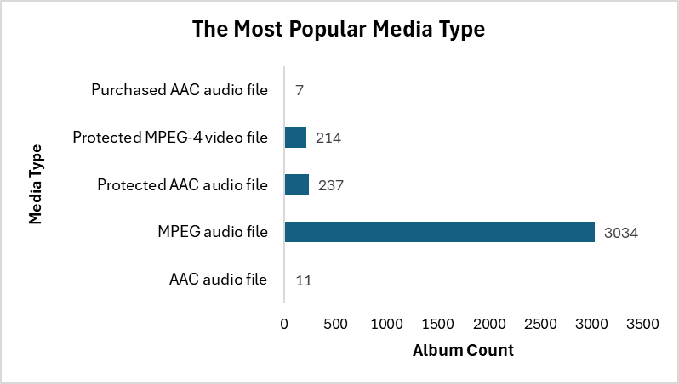
Media Type Frequency
From the data visual on the left, it indicate that there are 5 different Media type across the track Table.
The MPEG audio file Media type recorded the total count of 3,034 which is also Highest count of Media Type.

Slide 2
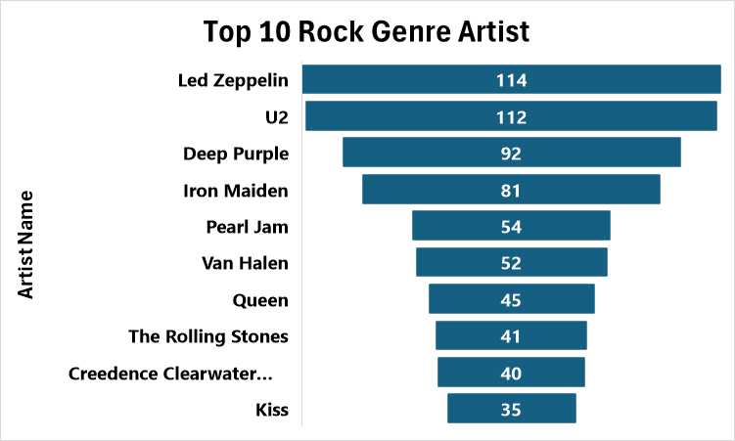
Top 10 Artist with the Most Rock Genre
The visual on the left indicate the top 10 Artist who has the most Rock genre in the Music DB with Led Zepplin with the highest record of 114 rock track and Kiss having least at 35 rock songs track.

Slide 3
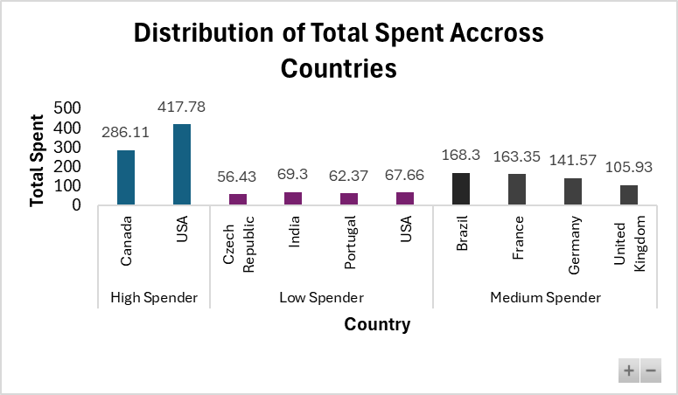
Top 10 Country Total_Spent By MediaType & Spending Categories
Group in 3 Categories (High, Medium and Low spender). Canada & USA fall under High Spender. USA being the highest with $417.78
Brasil, France, Germany, and United Kingdom falls under Medium. Brasil top the medium spender with $168.3
USA appears in both High & medium.

Slide 4
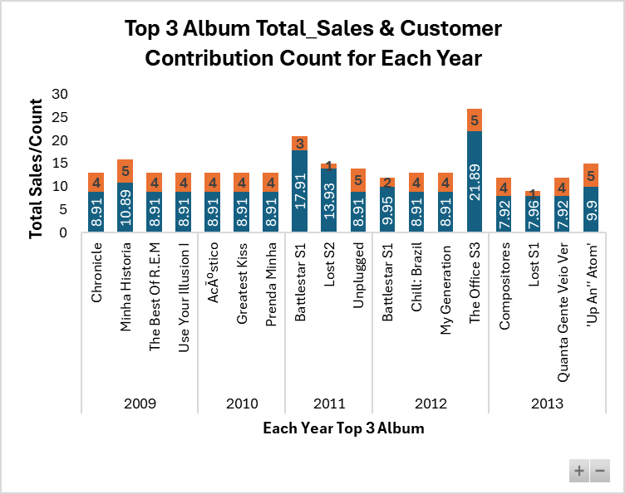
Top 3 Total Sales & Customer Contribution Count for Each Year
Each year shows the top 3 total sales which is in blue Column bar and the count of customer that contribute to the top 3 total sales in orange bar.
You would notice year 2009,2012 & 2013 has more than 3 Column bar this is because for year 2009 there are multiple Total sales ($8.91) of the same value, 2012 has 2x Total sales of ($8.91) and 2013 has 3x ($7.92).

